Slide 1

Cloud enabled restaurant finder app

Slide 2
gROUP MEMBERS - (team 18)
Donda, Vinay Kumar Reddy – 16326413
Gada, Sharanya – 16326779
Kilaru, Sai Madhav – 16330813
Perumalla, Venkata Krishna Meher – 16326787
Somisetty, Lakshmi Pravallika – 16330331 (Team Lead)

Slide 3
PRESENTATION ROADMAP
Cloud Computing – quick overview
Pros and Cons of Cloud
Different types of Cloud providers – Use of AWS in this project
Introduction to Restaurant finder app
Application Architecture
AWS Services involved
Associated Modules
Usage of the application
Summary

Slide 4
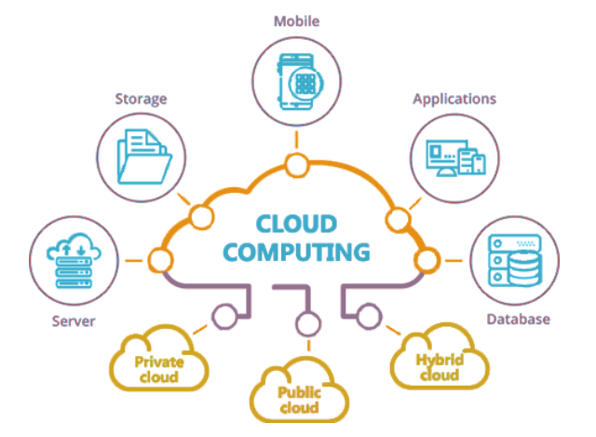
CLOUD COMPUTING - OVERVIEW
Cloud Computing is simply the delivery of computing services – that includes servers, storage, databases, networking, software, analytics and intelligence over the internet to offer faster innovation, flexible resources, and economies of scale.
Based on the concept of pay-as-you-go. You pay only for the services that one is using currently and can easily scale up and scale down the resources conveniently.

Slide 5


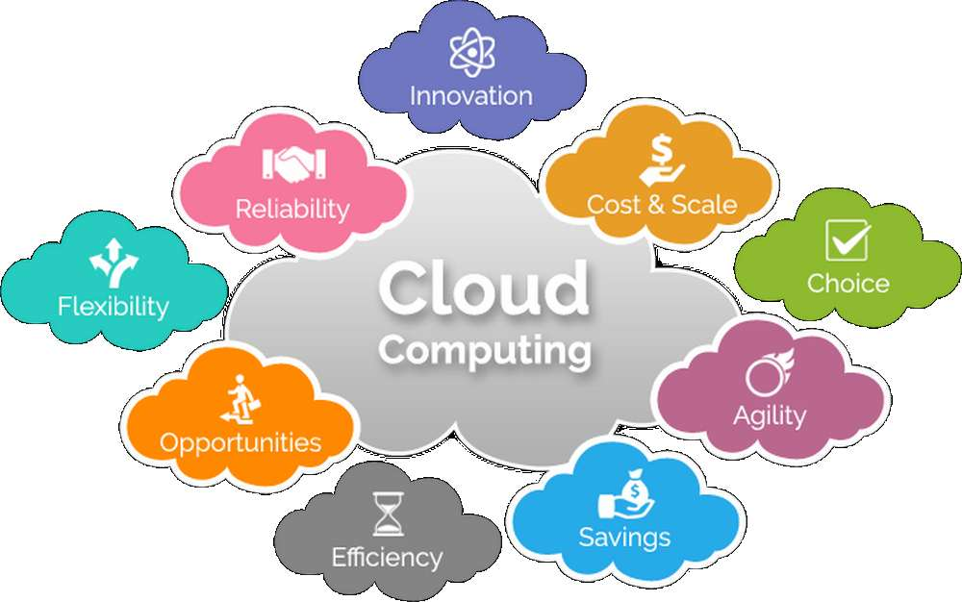
PROS AND CONS OF CLOUD
Cloud computing helps individuals and organization easily to:
Cut down costs related to hardware and software
Support flexible working schedules
Scale the computer resources
Perform reliable and robust backups of business-sensitive data.

Slide 6

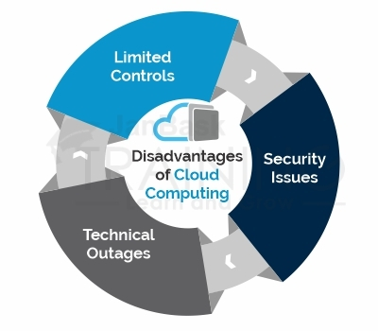
Some key Disadvantages of Cloud Computing:
Network Connection Dependency
Limited Features
Loss of Control
Security
Technical Issues

Slide 7

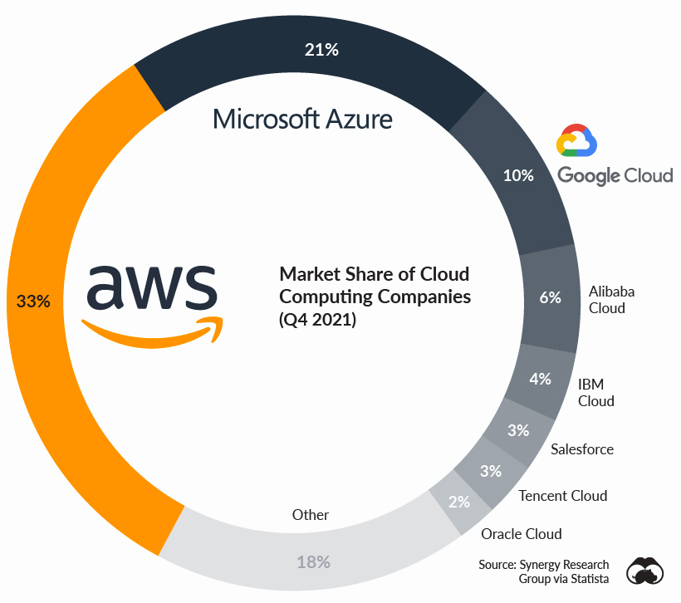
AWS
Amazon Web Services (AWS) is the world’s most comprehensive and broadly adopted cloud platform, offering over 200 fully featured services from data centers globally. Millions of customers—including the fastest-growing startups, largest enterprises, and leading government agencies—are using AWS to lower costs, become more agile, and innovate faster.
WHY AWS ?
AWS has more services, and more features within those services, than any other cloud provider, including compute, storage, databases, networking, data lakes and analytics, machine learning and artificial intelligence, IoT, security, and much more.

Slide 8
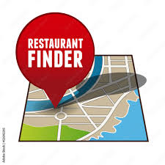
RESTAURANT FINDER APP
A simple serverless web application that enables users to request food from the KITCHENIFY fleet. The application will present users with an HTML based user interface for indicating the location where they would like to order food from and will interface on the backend with a RESTful web service to submit the request and dispatch the food. The application will also provide facilities for users to register with the service and log in before requesting food from their favorite restaurant.

Slide 9
APPLICATION ARCHITECTURE
The application architecture uses AWS Lambda, Amazon API Gateway, Amazon DynamoDB, Amazon Cognito, and AWS Amplify Console.
Amplify Console provides continuous deployment and hosting of the static web resources including HTML, CSS, JavaScript, and image files which are loaded in the user's browser.
JavaScript executed in the browser sends and receives data from a public backend API built using Lambda and API Gateway.
Amazon Cognito provides user management and authentication functions to secure the backend API.
Finally, DynamoDB provides a persistence layer where data can be stored by the API's Lambda function.

Slide 10
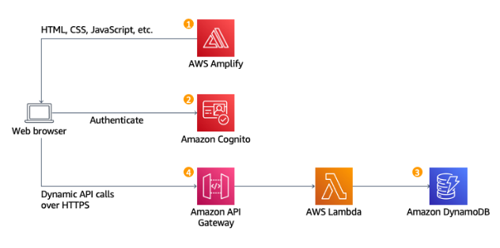
PICTORIAL REPRESENTATION

Slide 11
Detailed EXPLANATION
Static Web Hosting : AWS Amplify hosts static web resources including HTML, CSS, JavaScript, and image files which are loaded in the user's browser.
User Management : Amazon Cognito provides user management and authentication functions to secure the backend API.
Serverless Backend : Amazon DynamoDB provides a persistence layer where data can be stored by the API's Lambda function.
RESTful API: JavaScript executed in the browser sends and receives data from a public backend API built using Lambda and API Gateway.

Slide 12


AWS SERVICES INVOLVED
From the tons of AWS Services available today, in our project we focused on using the below mentioned services of AWS.
1. AWS Amplify: With AWS Amplify, building feature-rich, full-stack web and mobile apps has never been easier—from development to deployment. Get to market fast and scale as your business grows.
2. Amazon Cognito: Amazon Cognito lets you easily add user sign-up and authentication to your mobile and web apps. Amazon Cognito also enables you to authenticate users through an external identity provider and provides temporary security credentials to access your app's backend resources in AWS or any service behind Amazon API Gateway.

Slide 13



3. Amazon API Gateway: Amazon API Gateway is a fully managed service that makes it easy for developers to create, publish, maintain, monitor, and secure APIs at any scale. APIs act as the "front door" for applications to access data, business logic, or functionality from your backend services.
4. AWS Lambda: AWS Lambda is a serverless compute service that runs your code in response to events and automatically manages the underlying compute resources for you. These events may include changes in state or an update, such as a user placing an item in a shopping cart on an ecommerce website.
5. Amazon DynamoDB: Amazon DynamoDB is a fully managed, serverless, key-value NoSQL database designed to run high-performance applications at any scale. DynamoDB offers built-in security, continuous backups, automated multi-Region replication, in-memory caching, and data import and export tools.

Slide 14
MODULES
Hosting a static Website using AWS Amplify.
Managed Users using Amazon Cognito: Creating a user pool to manage all user’s accounts.
Building a Serverless Backend: To build a backend process for handling requests of the web application.
Deploy a RESTful API: Use of Amazon gateway to expose the lambda function as a RESTful API.

Slide 15
USAGE
All the resources like storage , server, API end points are provided by the cloud service provider making it very easy to implement with just having the source code.
We can scale up and down our resources any time.
No need for users to download any specific app on their systems, just by having the URL it can be accessed by customers depending on the region it is being developed.

Slide 16
SUMMARY
Use of various cloud services to implement the web based application and making it available to the users specific to the region that it is implemented for. Thus, Cloud enabled web based application is very useful for individuals to start-up their start-ups.

